Slide 1

Spotify
Phone, email, or username
Hiba Tanveer
Password
********
Log in
Forgot password? Sign up for Spotify

Slide 2


Slide 3
Notes:
Note: At the back of the logo there’s a loading gif

Slide 4

Floods
PLAY

Slide 5

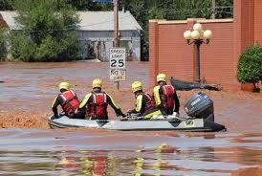
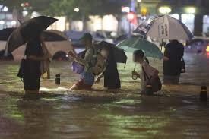
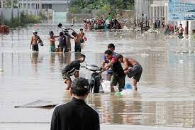
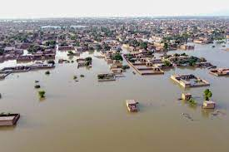
Group 1
Search
Flood in Pakistan
Introduction
Cause
Outcome
Prevention
SEE MORE

Slide 6
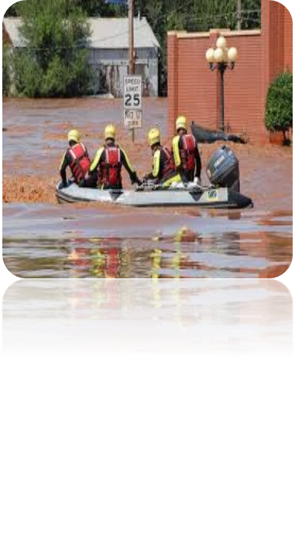



Group 1
Search
Introduction
What are floods?
PLAY
FOLLOWING
…
Floods are the most frequent type of natural disaster and occur when an overflow of water submerges land that is usually dry. Floods are often caused by heavy rainfall, rapid snowmelt or a storm surge from a tropical cyclone or tsunami in coastal areas. There are few places on Earth where people don’t need to be concerned about flooding. Generally, floods take hours or even days to develop, giving residents time to prepare or evacuate. Sometimes, floods develop quickly and with little warning. A flood can develop in many ways. The most common is when rivers or streams overflow their banks.
Intro

Slide 7

Group 1
Search
Pakistan Floods of 2010, flooding of the Indus River in Pakistan in late July and August 2010 that led to a humanitarian disaster considered to be one of the worst in Pakistan’s history. The floods, which affected approximately 20 million people, destroyed homes, crops, and infrastructure and left millions vulnerable to malnutrition and waterborne disease. Estimates of the total number of people killed ranged from 1,200 to 2,200, while approximately 1.6 million houses were damaged or destroyed, leaving an estimated 14 million people without homes.
Beginning 31 July 2013, Pakistan and parts of eastern Afghanistan experienced unusually heavy rainfall that caused widespread flash flooding. Flood waters began to recede on 5 August, but more heavy rain was expected later in August and September, the heart of monsoon season. All but one area of Khyber Pakhtunkhwa province in Pakistan was flood-free by 5 August, as the waters receded almost as quickly as they had risen.
Pakistan's flooding in 2022 is a combination of corruption, mismanagement, and climate change. Pakistan is currently experiencing one of the worst environmental disasters in the world. Over 1,325 people have died and 33 million have been impacted.
Intro

Slide 8
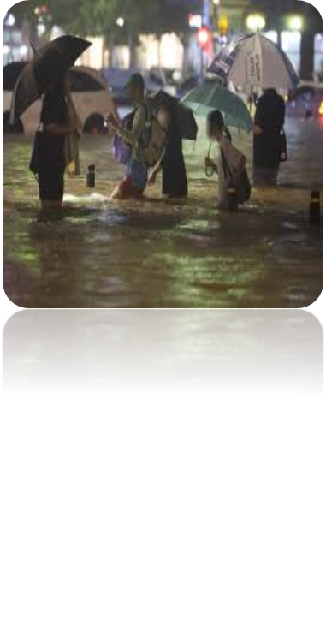

Group 1
Search
What caused the flood in 2022 in Pakistan?
PLAY
FOLLOWING
…
Since June 14, 2022, floods in Pakistan have killed 1,717 people. The floods were caused by heavier than usual monsoon rains and melting glaciers that followed a severe heat wave, all of which are linked to climate change. It is the world's deadliest flood since the 2020 South Asian floods and described as the worst in the country's history. On 25 August, Pakistan declared a state of emergency because of the flooding. The government of Pakistan has estimated losses worth US$40 billion from the flooding.
For some, Pakistan has not invested enough in climate-resilient infrastructure while for others, there is no way that Pakistan could have been prepared for this massive flooding. But the truth lies somewhere in the middle of mismanagement and climate change.
Cause

Slide 9

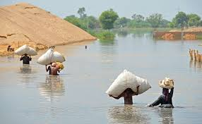
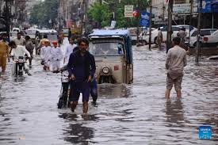
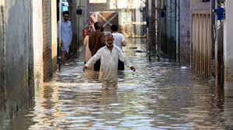
Group 1
Search
In the case of Pakistan, one of the main causes towards the flood is weak governance and cooperation. These factors have led to water mafias, illegal and unregulated construction, and poor urban and rural planning. While it can be argued that planning for a disaster of this magnitude is impossible, on the provincial level there should have been more forethought given to their plans, especially knowing that each year the monsoon rains become more intense.
But this disaster has shown that the majority of the damages that were caused by the flood waters were to structures that never should have been there in the first place.
Cause

Slide 10
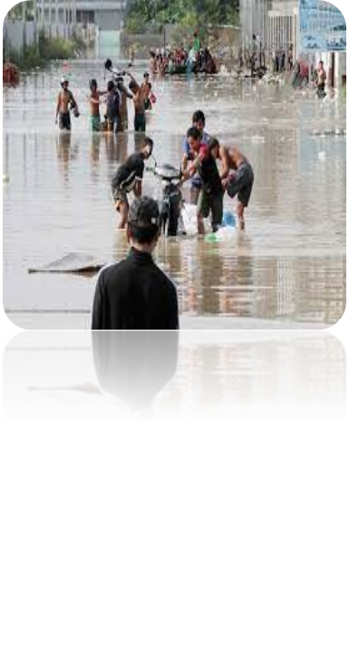
Group 1
Search
PLAY
FOLLOWING
…
How did the flood affected Pakistan?
Outcome

Slide 11
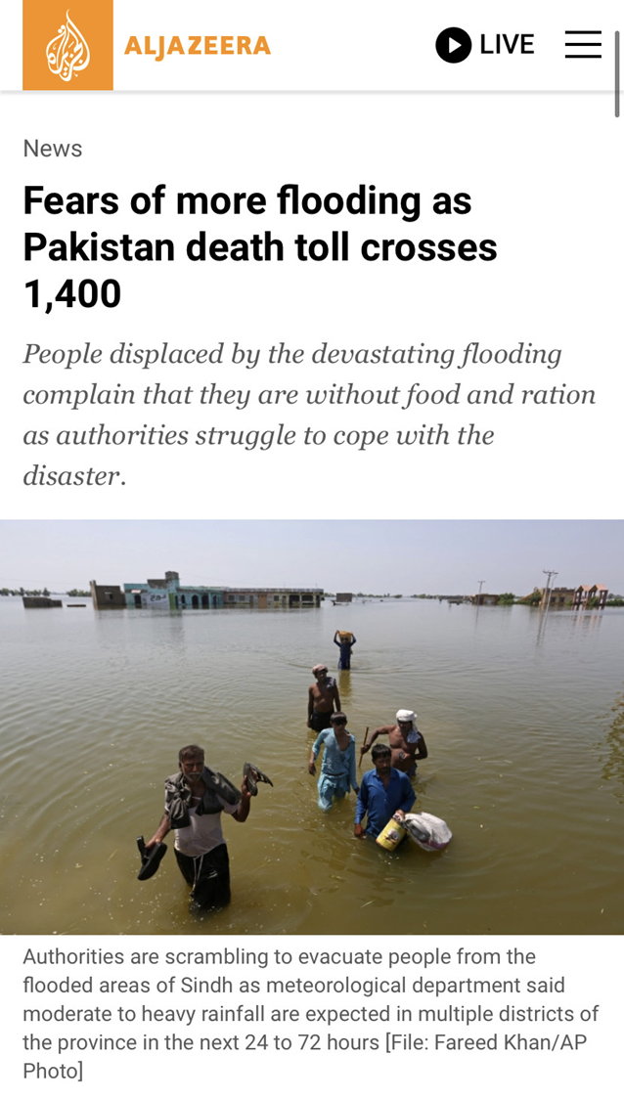
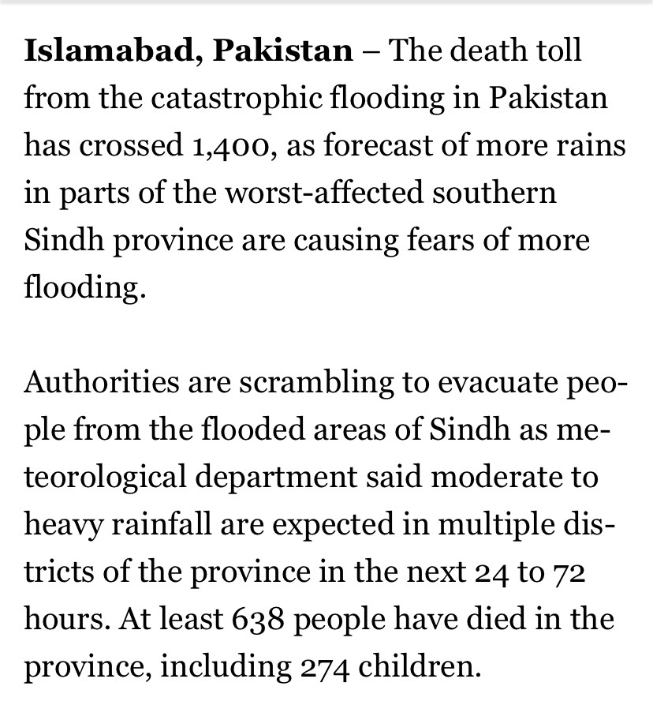
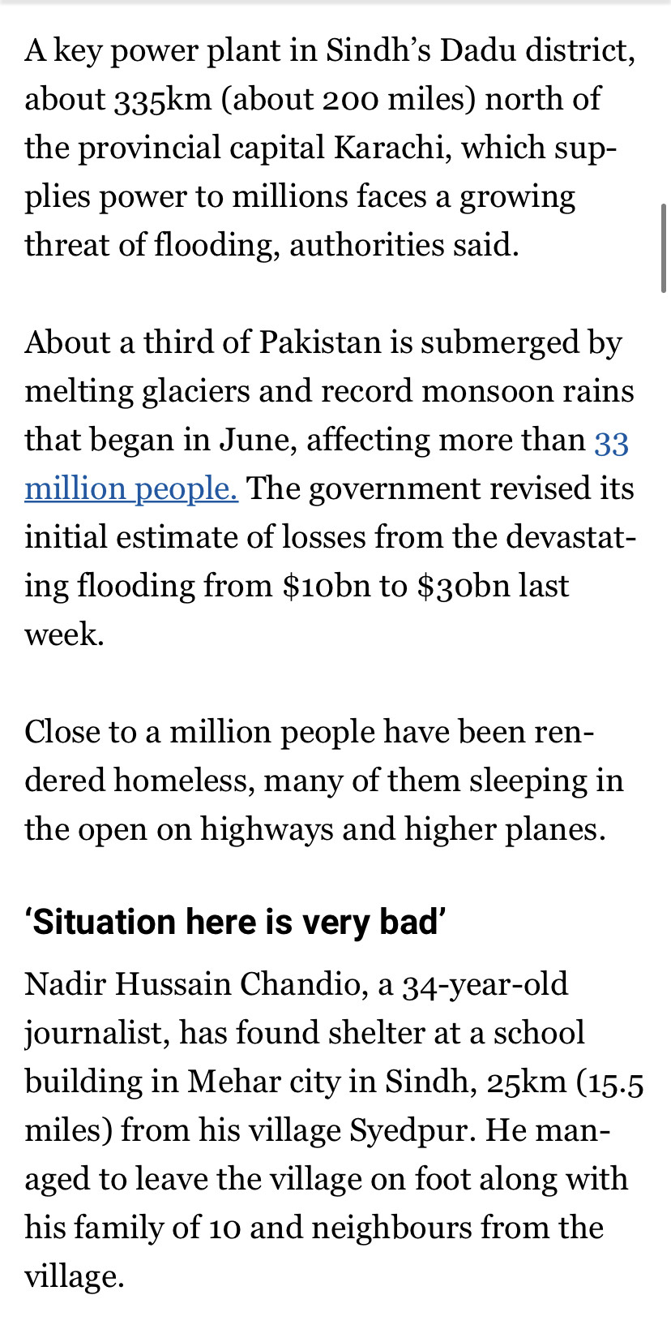

Slide 12
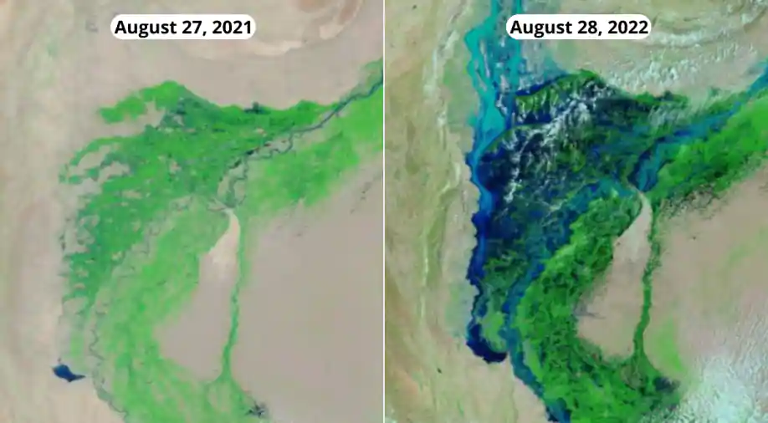
Group 1
Search
PLAY
FOLLOWING
…
How did the flood affected Pakistan?
Outcome

Slide 13
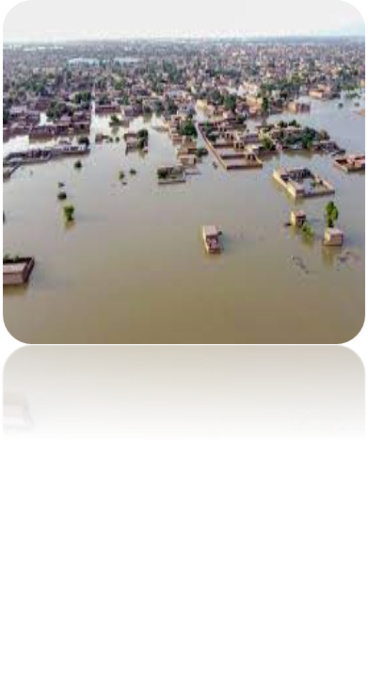
Group 1
Search
How to prevent floods in the future?
PLAY
FOLLOWING
…
Decades of research explain that disasters are instead caused by sources of vulnerability rather than by the climate or other environmental influences. Sources of vulnerability stem from a lack of power and resources to prepare for hazards. This includes poorly designed infrastructure along with social management and inequity, which restrict access to education and other key services.
Prevention

Slide 14
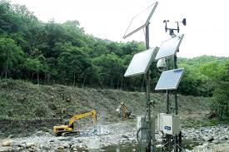

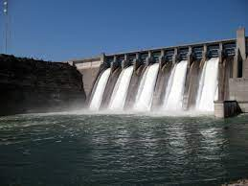
Group 1
Search
1. Flood Detection Systems: The installation of flood warning systems close to any significant canal or body of water gives vital information that can protect properties from excessive damage and save lives.
2. Plant More Trees: Planting more trees will only benefit the environment. The government must take action to plant trees since it will benefit the environment and also help to avert flooding.
3. Construction of Dams: Dams are one of the most important concerns in Pakistan as they have the potential to solve many power-related problems the country is incurring. Dams are the best way to prevent flooding anywhere because they are the largest infrastructure for storing water for later use.
Prevention

Slide 15







Group Members
Aida
Hiba
Negar
Iman
FOLLOW
FOLLOW
FOLLOW
FOLLOW
SHUFFLE PLAY

Slide 16
Thanks for tuning in
Don’t forget to like and subscribe to our channel.

